Slide 1

FALL 2015
IN-SERVICE
ATHENS STATE UNIVERSITY

Slide 2
WELCOME
DR. RON INGLE
https://vimeo.com/135576922

Slide 3
DR. ROBERT GLENN
PRESIDENT

Slide 4
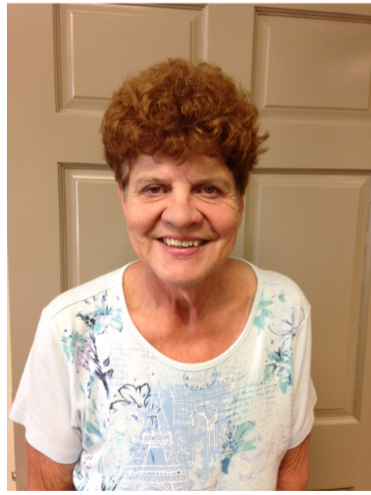
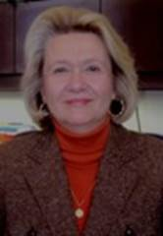
RETIREMENTS
Dorothy Bartlow
Celeste Bedingfield
September 1, 2015

Slide 5
RETIREMENTS
Sandra Brock
Dr. Robert Burkhardt

Slide 6
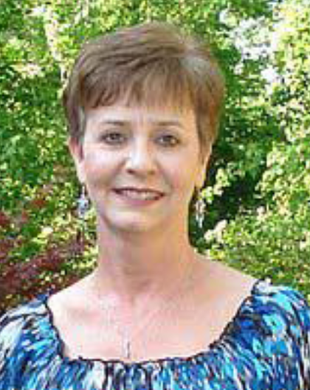
RETIREMENTS
Barbara Burks
Linda Hemingway

Slide 7
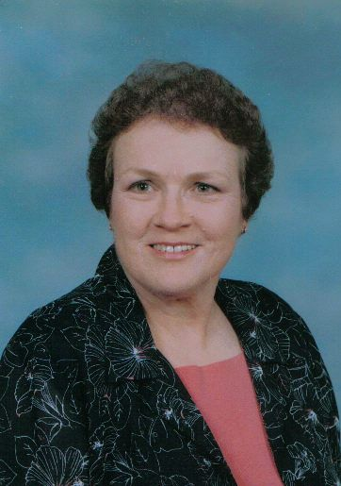
RETIREMENTS
Norma Jackson
Dr. Pat Kuby
September 1, 2015

Slide 8
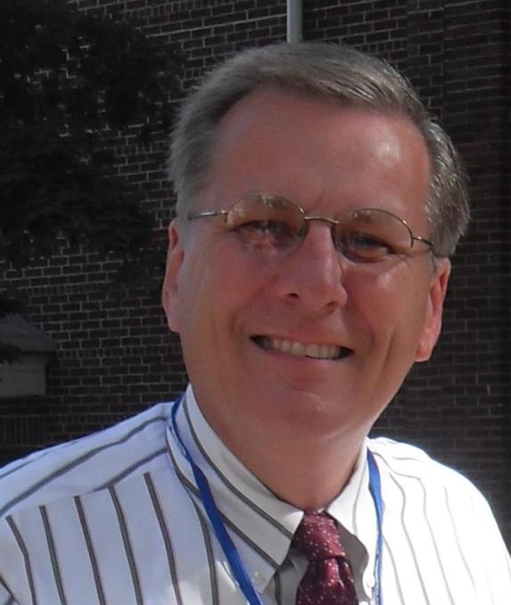
RETIREMENTS
Rick Mould
Debbie Phillips

Slide 9
RETIREMENTS
Wanda Pryor
Shirley Troupe

Slide 10
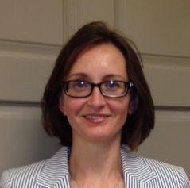
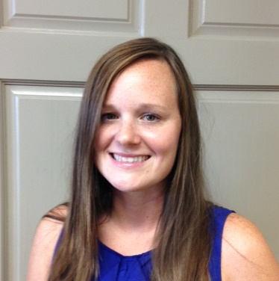
NEW FACES
Dr. Joy Bracewell
Writing Center Director
Bethany Campbell
Admissions Advisor
Notes:
Does not include changes in positions
These are people who are new to Athens State University!

Slide 11
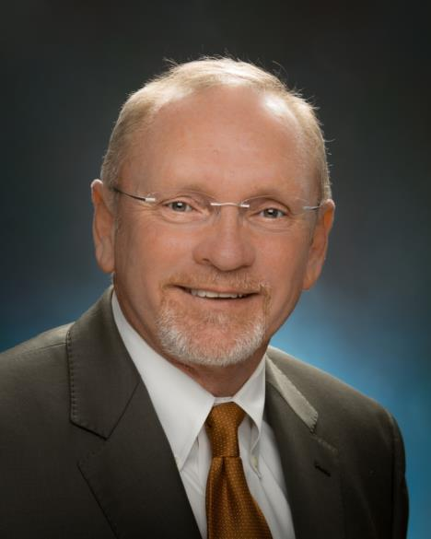
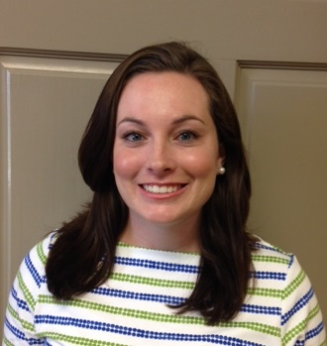
NEW FACES
Dr. Keith Ferguson
Vice President for University Advancement
Ashley Haley
Admissions Advisor
Notes:
Does not include changes in positions
These are people who are new to Athens State University!

Slide 12
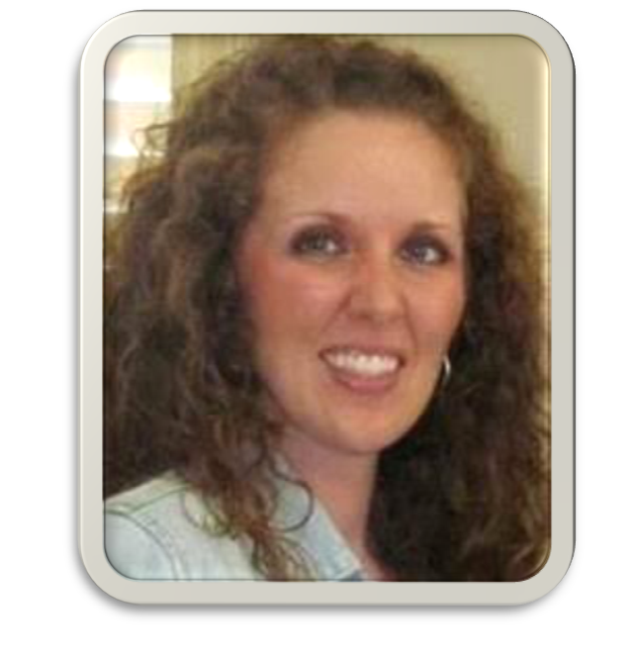
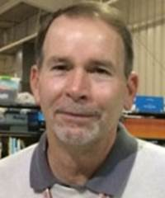
NEW FACES
Nikki Hatton
Admissions Advisor
Robert Hilley
Materials Assistant (AMSTI)
Notes:
Does not include changes in positions
These are people who are new to Athens State University!

Slide 13
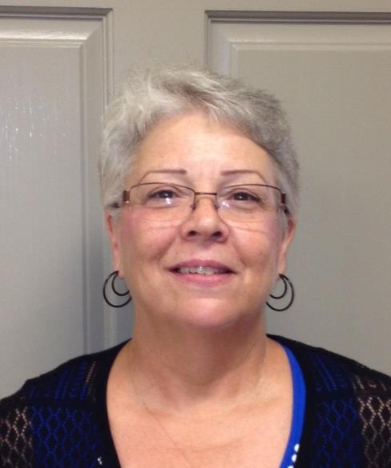
NEW FACES
Callie Patterson
Admissions Advisor
Carol Rachal
Secretary to the President
Notes:
Does not include changes in positions
These are people who are new to Athens State University!

Slide 14
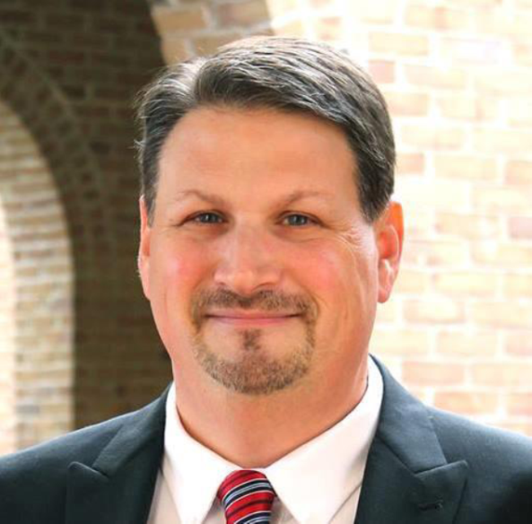
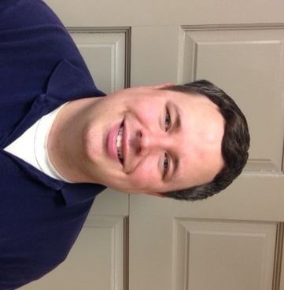
NEW FACES
Terry Stepp
Director of Campus and Community Engagement
Randy Wells
Information Technology
Support Specialist
Notes:
Does not include changes in positions
These are people who are new to Athens State University!

Slide 15
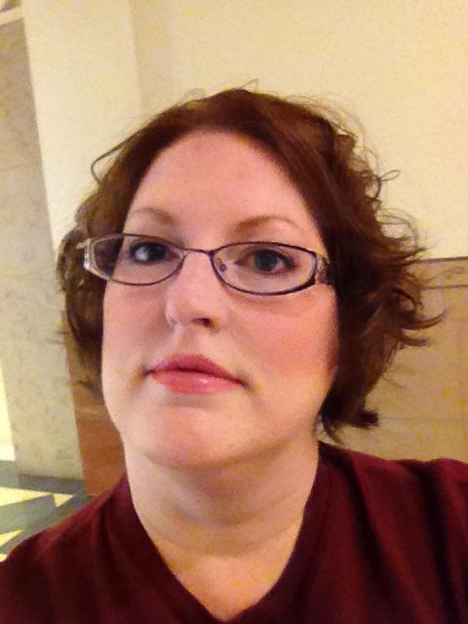
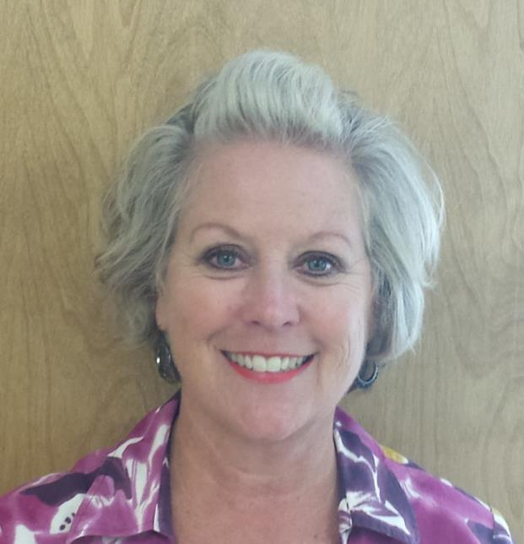
NEW FACES
Jennifer Williams
Acquisitions and Collection
Development Librarian
Deborah Wilson
Director of Clinical Experiences
Notes:
Does not include changes in positions
These are people who are new to Athens State University!

Slide 16
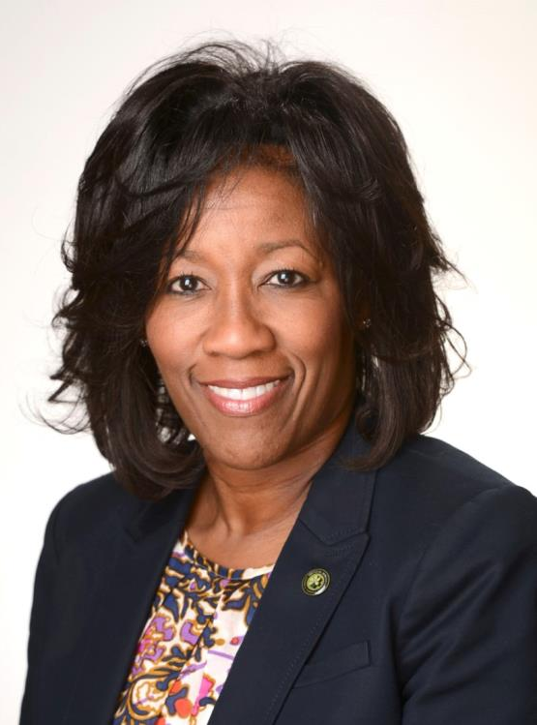
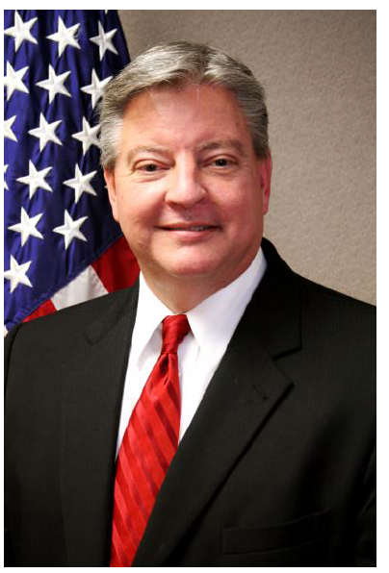
NEW FACES
Athens State University Board of Trustees
Crystal Brown
Ronnie Chronister
Notes:
Does not include changes in positions
These are people who are new to Athens State University!

Slide 17
EMERITI
Dr. Robert Burkhardt
Barbara Burks

Slide 18


EMERITI CONFERMENT

Slide 19
MR. MIKE MCCOY
Vice President for Finance

Slide 20

2015-2016 APPROVED BUDGET

Slide 21
BUDGET ADVISORY COMMITTEE
COE representative – Lisa Hyde
COB representative - John Berzett
COAS representative – Sara Cline
Staff Senate Officer – Damon Lares
Faculty Senate Officer – Robert White
Business Manager – Evan Thornton
Ex. Asst. VP of Fin. Affairs – Barbara Ferguson
Vice President of Fin. Affairs – Mike McCoy

Slide 22
Budget Summary 2015-2016 Fiscal Yearscal Year
 |  | Current Fund Group
 |  |  |  | Unrestricted |  |  |  | Plant
 |  | Unrestricted |  | Auxiliary |  | Restricted |  | Funds
Estimated Beginning Fund Balance as of 10/1/15 |  | $6,963,825 |  | $213,498 |  | $349,872 |  | $2,801,885
Add
Revenues |  | $30,832,396 |  | $363,000 |  | $22,961,900
Transfers In |  |  |  | $50,000 |  |  |  | $5,756,990
Total Estimated Additions |  | $30,832,396 |  | $413,000 |  | $22,961,900 |  | $5,756,990
Total Funds Available |  | $37,796,221 |  | $626,498 |  | $23,311,772 |  | $8,558,875
Deduct
Expenditures |  | $28,025,406 |  | $411,944 |  | $22,934,797 |  | $4,850,000
Transfers Out |  | $2,806,990 |  |  |  |  |  | $1,719,763
Total Estimated Deductions |  | $30,832,396 |  | $411,944 |  | $22,934,797 |  | $6,569,763
Estimated Ending Fund Balance as of 9/30/16 |  | $6,963,825 |  | $214,554 |  | $376,975 |  | $1,989,112

Slide 23
How does the budget affect you?
Cost of Living Increase of 2% for all permanent employees
$409,408 including benefits
Step Raises and Other Annual Increases
$75,699 including benefits
Promotions - Faculty and Staff
$66,108 including benefits

Slide 24
APPROVED TUITION & FEE
SCHEDULE 2015-16
Tuition and Fees per credit hour | Instate | Out of State
Regular Tuition-Undergraduate | 184 | 368
Regular Tuition-Graduate | 325 | 500
Distance Learning Rate-Undergraduate | 264 | 264
Distance Learning Rate-Graduate | 325 | 325
Special Building Fee | 6 | 6
Facilities Renewal Fee | 9 | 9
Technology Fee | 9 | 9
Bond Reserve Fee | 1 | 1
Other Student Fees
Application/Transfer Fee | 30 | 30
Student Fee (per semester) | 25 | 25
Late Fee * | 35 | 35
Lab Fee (as specified per course) | 53 | 53
Auditing Fee per hour | ½ of applicable tuition rate | ½ of applicable tuition rate
Blended Course Fee | 50 | 50
Teaching Internship Fee | 180 | 180
Graduation Fee | 50 | 50
Returned Check Fee | 30 | 30
* Late registration/late payment

Slide 25



A BIG “Thank You” to our
Grounds Crew for all of the
work they have done around campus
and especially the courtyard!!

Slide 26
DR. RON INGLE
INTERIM VICE PRESIDENT FOR
ACADEMIC AFFAIRS /PROVOST

Slide 27
EMPLOYMENT SEARCH UPDATE
Vice President for Academic Affairs/Provost
Robert Burkhardt (Chair) Felecia Mucci Jeff Johnson
Robert White (Co-Chair) Victoria Baker Wendy Cowan
Belinda Krigel Ronnie Merritt Johnnie Lundin
Sarah McAbee Susan Owen
Damon Lares Jacob Gatlin
Kar’Michay Pope – Student Representative
Denver Betts – Community Representative

Slide 28
EMPLOYMENT SEARCH UPDATE
Library Director
                Jess Brown (Chair)
                Del O’Neal
                Jennifer Wolfe
                Jameha Gardner
                Teresa Wanbaugh
                Kimberly Jack

Slide 29

GRADUATE PROGRAM UPDATE
COMING SPRING 2016
Online Applications available September 1st
Application Deadline November 2nd
http://www.athens.edu/graduate-programs/
http://www.athens.edu/masters/

Slide 30
GRADUATE PROGRAM UPDATE
COMING FALL 2016
M.A.
Religious Studies

Slide 31


ACCREDITATION UPDATE
ABET – September
B.S. in Computer Science Program
ACBSP – February 2016
COB Programs

Slide 32
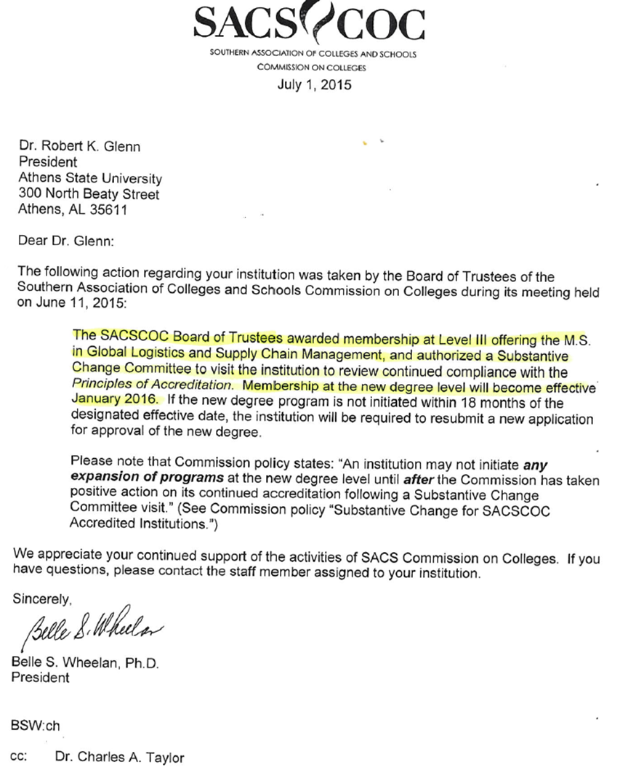
On-Site Visit
Graduate Programs
March 1-3, 2016

Slide 33
ONGOING PROJECTS AND POLICY DEVELOPMENT
Teaching Grants
Sabbatical Leave
Tenure and Promotion
Research Policy
Faculty Credentials

Slide 34
DR. JOY BRACEWELL
Writing Center Director

Slide 35
Writing Across Campus
Continuing a Culture of
Writing and Communication

Slide 36
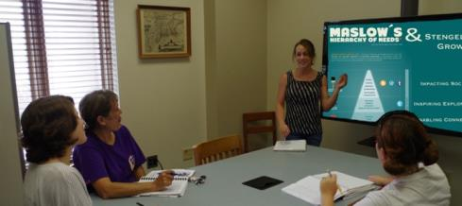


WRITING CENTER UPDATE
  New website
  /
  Forging toward Multimodality:
    Presentations (Capstones)
    Websites
    Digital Writing (Blogs)
  Library & WC Workshops
  New Tutors/Consultants
  Like us on Facebook
  Follow us @AthensWritingC
Fall 2015 Contest
  Writing Center Contest
  Rename the Center and create a tagline for us.
  Send in your ideas, accompanied by a (75-word) statement
  Increase your chances for success by pairing your entry with a witty meme, poster, video, cartoon, drawing, etc.
brought to you by
the Writing Advisory Committee
http://www.athens.edu/writing-center

Slide 37
MS. BELINDA KRIGEL
Chief Information Officer

Slide 38
HELP DESK SERVICES
All Technology Assistance – Please contact the Help Desk directly instead of individuals directly. Your request will be relayed to the assigned person who can assist you.
Help Desk tickets can be submitted as follows:
Email HelpDesk@Athens.edu
Call: 256-216-6698
Visit: Waters Hall S202

Slide 39
TECHNICAL TRAINING
Training Sessions for Fall 2015 – register online at: http://www.athens.edu/ats/training/
Athens State Face-to-Face Classroom Technology
August 14, 3:00 pm, Classroom Building 104.
Online Course Development
See online schedule

Slide 40
TECHNOLOGY UPGRADES
Wireless network upgraded – More coverage in academic buildings and exterior areas in front of Founders and between Sanders and Brown.
Exchange E-Mail Upgraded – Exchange 2013
Banner hardware and storage
Windows 10 – Reviewing security,
Spring 2016 implementation

Slide 41
MS. SARAH MCABEE
Vice President
for Enrollment and Student Services

Slide 42
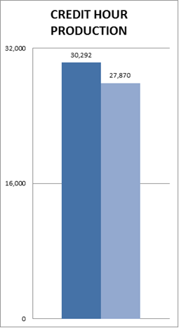
FALL ENROLLMENT 2015
(As of 8/12/2015)
Current Enrollment
2951 students
28,060 credit hours
Projected budget for Fall
30,292 credit hours
Regular registration continues through 8/14/2015
Late registration 8/24/2015

Slide 43
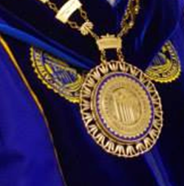
DR. ROBERT GLENN
PRESIDENT

Slide 44

CAPITAL CAMPAIGN
Cash and Non-Cash Contributions
June 1, 2012 – May 31, 2015
$2,109,392
Outstanding Pledges as of
May 31, 2015
$1,431,062
Total of Cash and Non-Cash Contributions and Pledges
$3,540,454

Slide 45
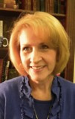
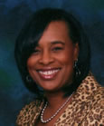
FACULTY PROMOTIONS
Dr. Janet Dorning
Professor
Dr. Rosemary Hodges
Professor

Slide 46
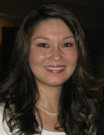
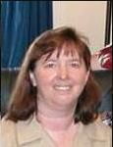
FACULTY PROMOTIONS
Dr. Lisa Hyde
Associate Professor
Dr. Cathy Woodruff
Associate Professor

Slide 47
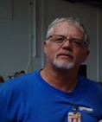
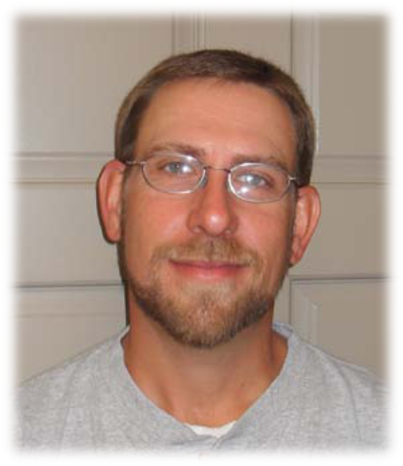
STAFF PROMOTIONS
Donald Evans
Brent Gooch

Slide 48
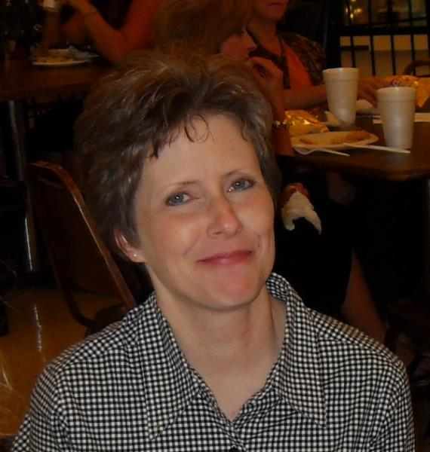
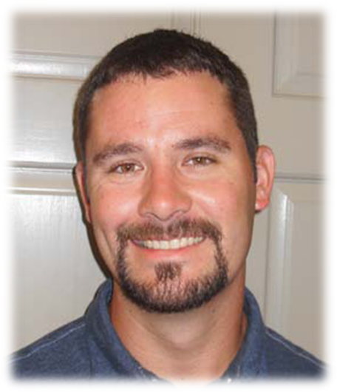
STAFF PROMOTIONS
Kelly Leigeber
Will Little

Slide 49
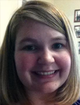
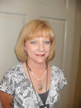
STAFF PROMOTIONS
Chelsea Love
Penny Pitts

Slide 50

INDIVIDUAL MERITORIOUS AWARDS
Recognizes employees for single efforts of employee performance that meets or exceeds expectations as defined by the University vision, mission, goals and college specific goals and objectives.
Recognizes employees who provide outstanding service, implements a substantive new idea, or meaningfully contributes to or designs an organizational initiative that reflects above and beyond what is expected to be recognized and rewarded for these singular efforts.
Kim Braden
Dr. Amanda Branscombe
Pam Bridges
Dr. Mike Haghighi
Dr. Rosemary Hodges
Dr. Quanda Stevenson

Slide 51

PRESIDENTIAL AWARD
FOR
MERITORIOUS PERFORMANCE
Recognizes employees who have demonstrated sustained quality and excellence in the performance of their duties.
Recognizes employees whose continued high performance significantly improves operations and outcomes in an area, or department.
Laura Lynn Kerner

Slide 52






SERVICE
AWARDS

Slide 53
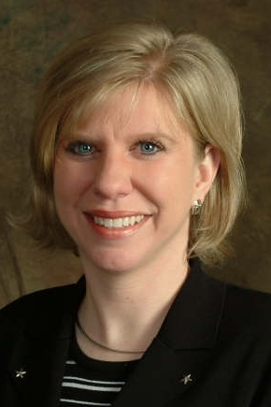
5
YEAR
Kim Bell

Slide 54
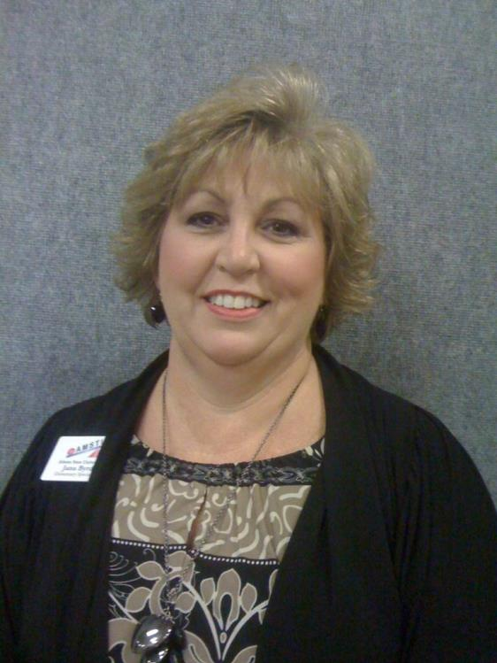
5
YEAR
Jana Byrd

Slide 55
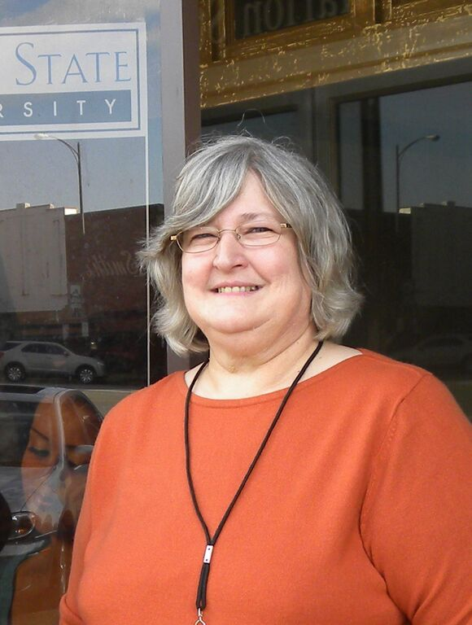
5
YEAR
Wanda Campbell

Slide 56
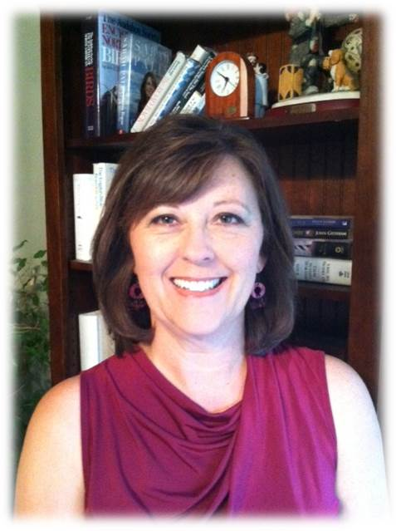
5
YEAR
Phyllis Claxton

Slide 57
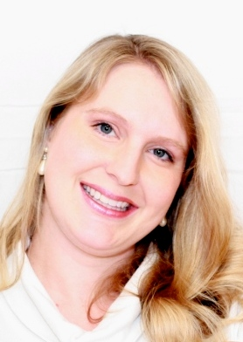
5
YEAR
Emily Corzine

Slide 58
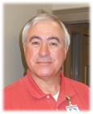
5
YEAR
Steve Downs

Slide 59
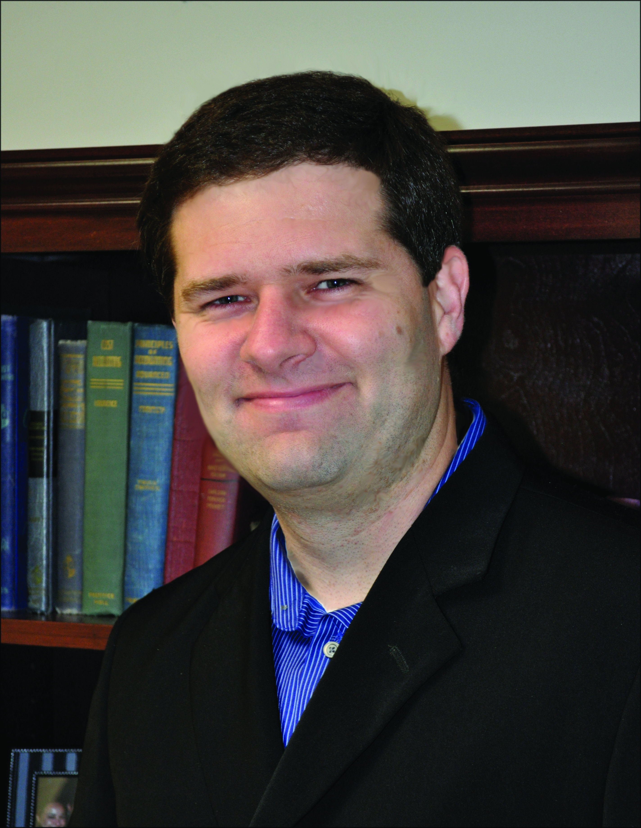
5
YEAR
Mark Gale

Slide 60
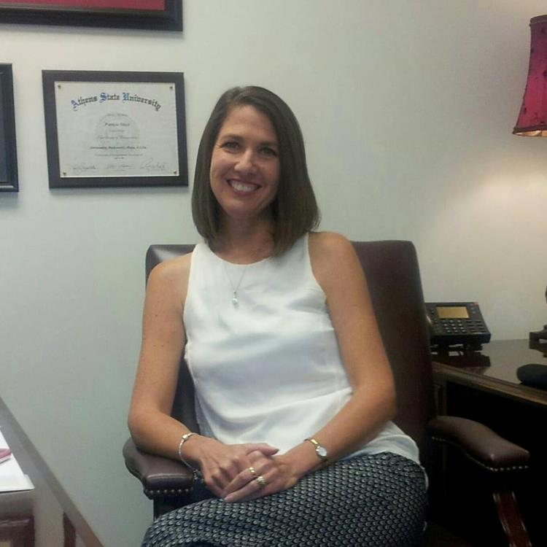
5
YEAR
Patsy Glaze

Slide 61
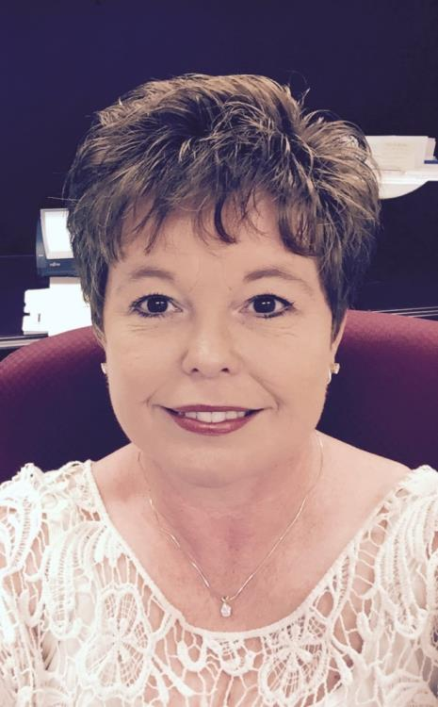
5
YEAR
Jackie Gooch

Slide 62
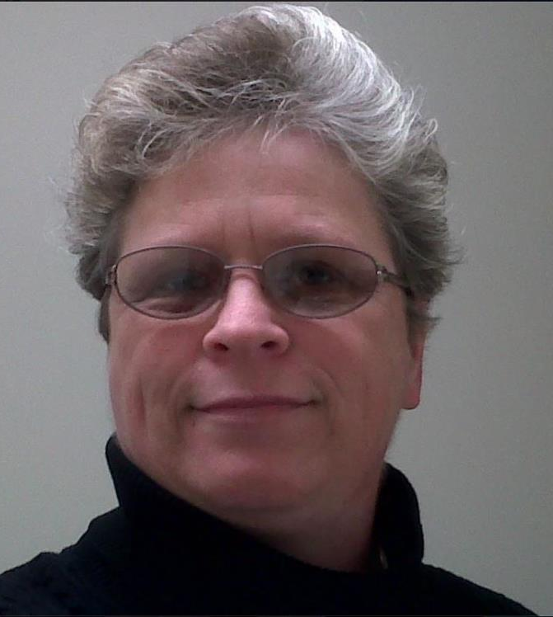
5
YEAR
Amy Hardeman

Slide 63
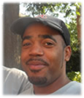
5
YEAR
Shaun Lockett

Slide 64
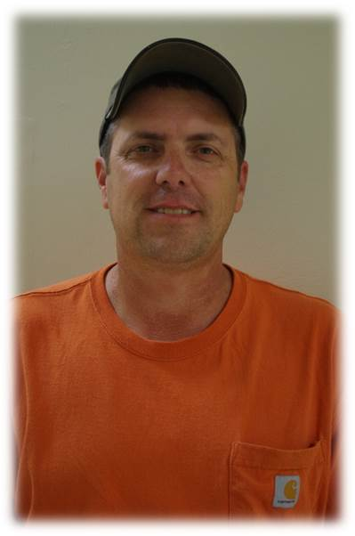
5
YEAR
Chris Moss

Slide 65
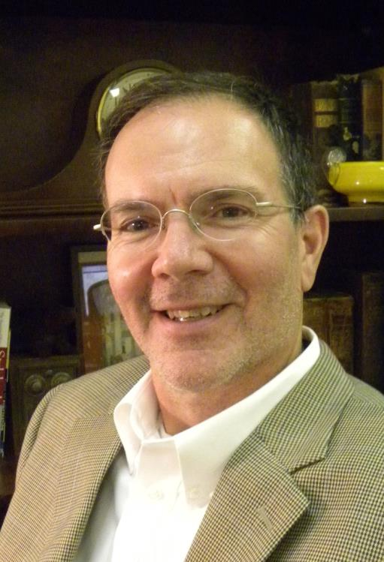
5
YEAR
Wade Myhan

Slide 66
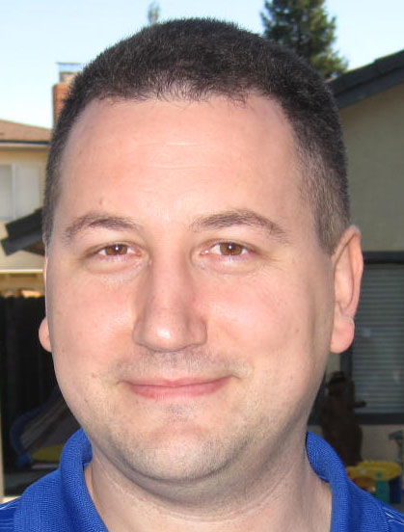
5
YEAR
Derek Newland

Slide 67
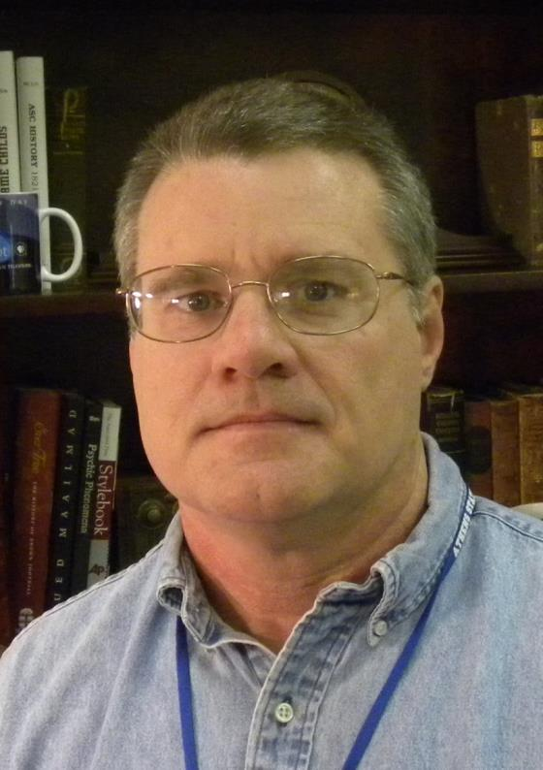
5
YEAR
Del O’Neal

Slide 68
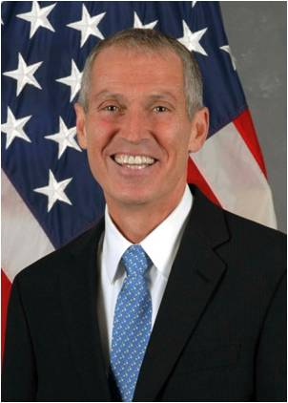
5
YEAR
Tom Pieplow

Slide 69
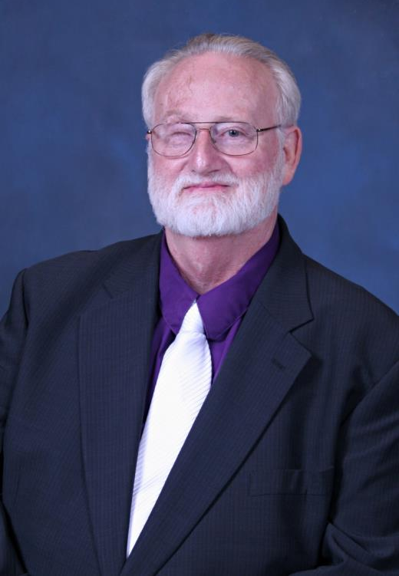
5
YEAR
Rick Roberts

Slide 70
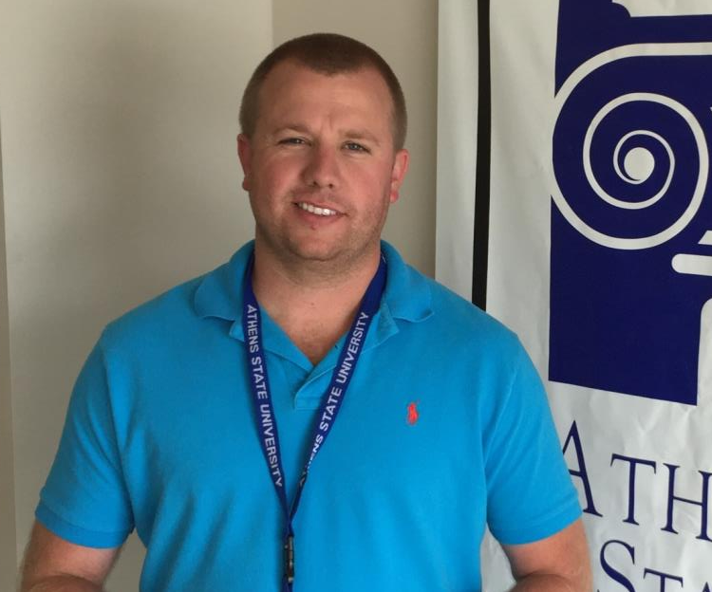
5
YEAR
Cody Smith

Slide 71

5
YEAR
Evan Thornton

Slide 72

10
Y
E
AR
Pat Bradford

Slide 73

10
Y
E
AR
Amanda Branscombe

Slide 74

10
Y
E
AR
Bridgette Chandler

Slide 75

10
Y
E
AR
Jill Cook

Slide 76

10
Y
E
AR
Malcolm Cort

Slide 77

10
Y
E
AR
Helen Crider

Slide 78

10
Y
E
AR
Ron Fritze

Slide 79

10
Y
E
AR
Mary Harris

Slide 80

10
Y
E
AR
Trevor Harris

Slide 81

10
Y
E
AR
Stacie Hughes

Slide 82

10
Y
E
AR
Lisa Hyde

Slide 83

10
Y
E
AR
Debra Kelley

Slide 84

10
Y
E
AR
Kim LaFevor

Slide 85

10
Y
E
AR
Jowanda McNeil

Slide 86

10
Y
E
AR
Barry Moley

Slide 87

10
Y
E
AR
Dana Waldrop

Slide 88

15
Y
E
AR
Gail Bergeron

Slide 89

15
Y
E
AR
Rosemary Hodges

Slide 90

15
Y
E
AR
Patluke Ragucci

Slide 91

15
Y
E
AR
Beth Reed

Slide 92

15
Y
E
AR
Deborah Tarpley

Slide 93

15
Y
E
AR
Sherry Weathers

Slide 94

15
Y
E
AR
Cathy Woodruff

Slide 95

25
Y
E
AR
Carla Breeding

Slide 96

25
Y
E
AR
Jess Brown

Slide 97

25
Y
E
AR
Kenneith Collins

Slide 98

25
Y
E
AR
Sheila Davis

Slide 99

25
Y
E
AR
Tracy Hicks

Slide 100

25
Y
E
AR
Bryan Kennedy

Slide 101

25
Y
E
AR
Sarah McAbee

Slide 102

25
Y
E
AR
Molly Pepper

Slide 103

25
Y
E
AR
Diann Shelton

Slide 104

30
Y
E
AR
Joe Bullington

Slide 105

30
Y
E
AR
Barry Devine

Slide 106

30
Y
E
AR
James Hand

Slide 107

30
Y
E
AR
Tina Hicks

Slide 108

35
Y
E
AR
Necedah Henderson

Slide 109

40
Y
E
AR
Dwight Lovell

Slide 110



ANNOUNCEMENTS
Fiddler’s Convention
October 2-3, 2015
Board of Trustees Meeting
October 16, 2015
Athens Storytelling Festival
October 23-24, 2015

Slide 111
ANNOUNCEMENTS
Staff group picture in front of gym directly after in-service program this morning

