Slide 1

Faculty/Staff Meeting
January 31, 2014

Slide 2


ACCREDITATION UPDATE
NCATE (CAEP) AND STATE REVIEW
College of Education
The written report for the NCATE reaccreditation is due in February.
On-site visit scheduled for October 18-21, 2014
State review report received. Mathematics (secondary education certification) and Physical Education certification programs met all standards. 11 other programs must submit follow-up reports.

Slide 3

ACCREDITATION UPDATE
Accreditation Council for Business Schools and Programs (ACBSP)
College of Business
Quality Assurance report was reviewed and accepted by ACBSP with no further information needed.

Slide 4

FACULTY AND STAFF POSITIONS
Two Dean searches complete
College of Business: Dr. Kim LaFevor
College of Education: Dr. Pat Sims
Two faculty searches complete (Accounting):
  Jacob Gatlin, Joshua Zender
Staff Hires:
  Recruiters: LeeAnna Brown,Tovah Gibson
  Secretary, AMSTI: Holly Wood

Slide 5
SEARCHES IN PROGRESS
Faculty: College of Arts & Sciences (2)
      College of Education
      Librarian
Staff: Assistant Vice President of Enrollment Management
      College of Education

Slide 6

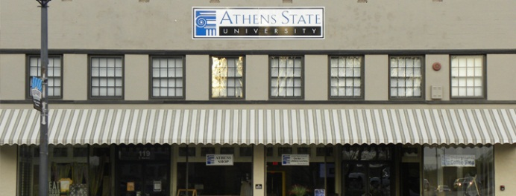
ACADEMIC AFFAIRS HIGHLIGHTS
Four new minors approved
Computer Forensic minor
Human Development minor
Finance minor
English Language Learner minor
Athens State University’s Accounting Department
has received the Institute of Management
Accountants (IMA) National Endorsement.
The Center for Lifelong Learning (CLL) will be hosting an “Our Town” series beginning in January.

Slide 7

TECHNOLOGY UPDATE
16 instructor podium computers are being upgraded in Waters Hall classrooms.
Four computer equipped classrooms located in Waters Hall N205, S104, N101, and S105 are receiving new computers for students.
The campus internet bandwidth was upgraded from 50 to 100 megabits on December 19, 2013 by Alabama Supercomputer.

Slide 8


TECHNOLOGY UPDATE
Two staff members in Information Technology Services, Bud Gifford and Damon Lares, have attended a total of three weeks training on Redhat Linux in preparation for the Degree Works implementation.
An integrated help desk work order system called Zendesk was implemented by Information Technology Services in January 2014 to improve work order tracking and technology support.

Slide 9
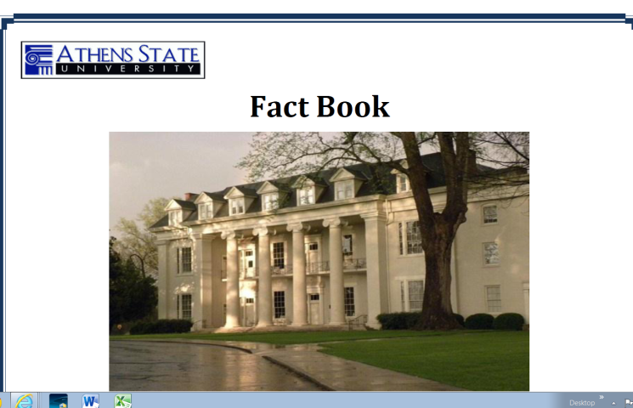
INSTITUTIONAL RESEARCH AND ASSESSMENT SERVICES
Completed the Athens State University Fact book that includes institutional data from Fall 2009 through Fall 2013

Slide 10
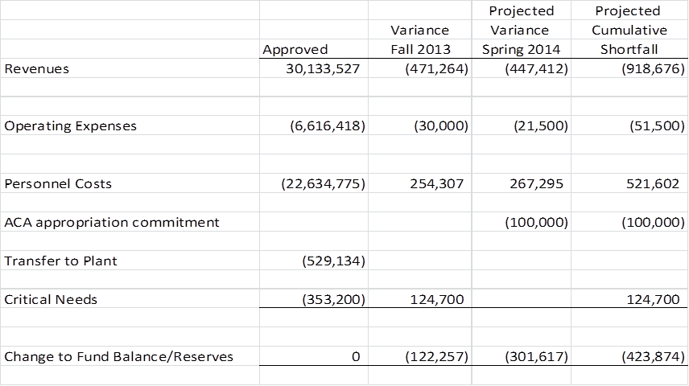
2013-2014 BUDGET UPDATE

Slide 11
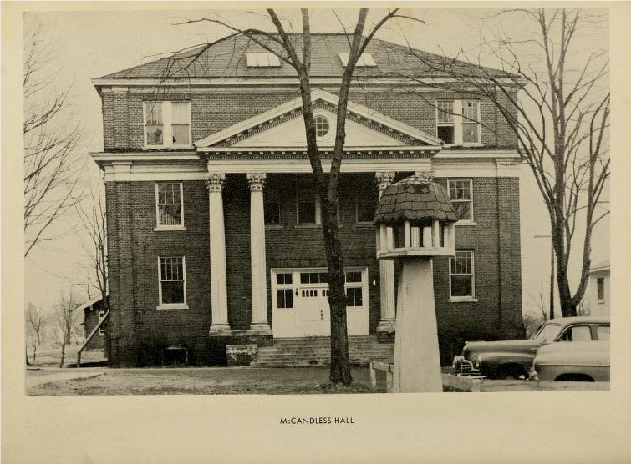
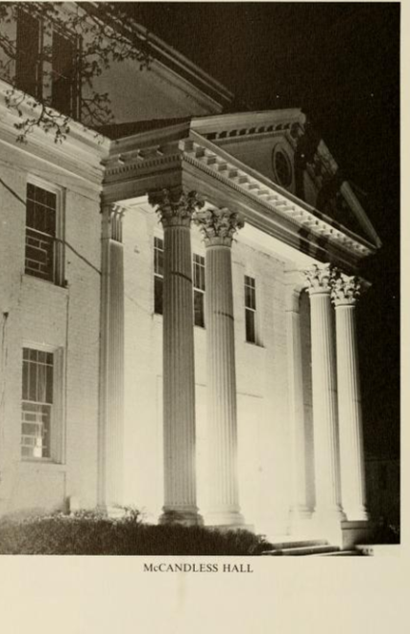
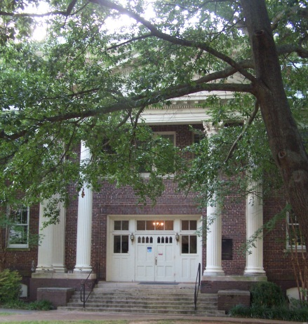
CAMPUS PROJECTS
McCandless Hall – Final inspection by
Alabama Building Commission projected
for February 2014
College Street Centre – Final inspection of
new roof by Alabama Building Commission
completed in December 2013
Parking Lots – Re-painting and striping
to be completed over the next few
months
Signage – New traffic and directional
signs are being ordered for campus
streets and drives

Slide 12
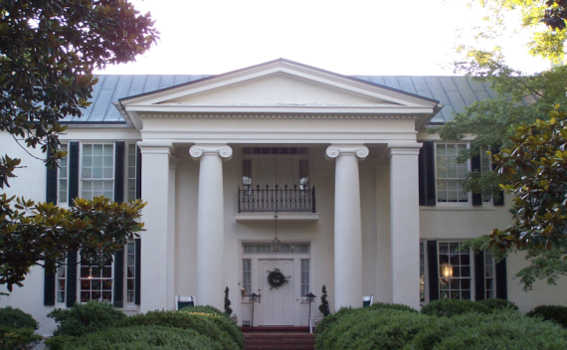
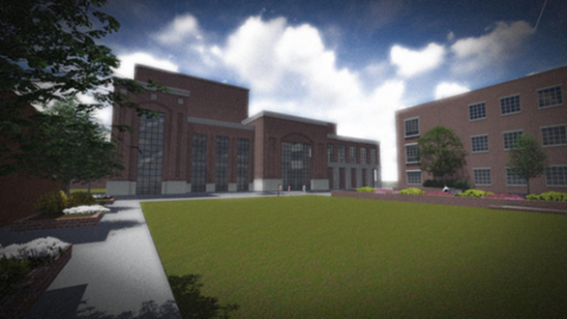
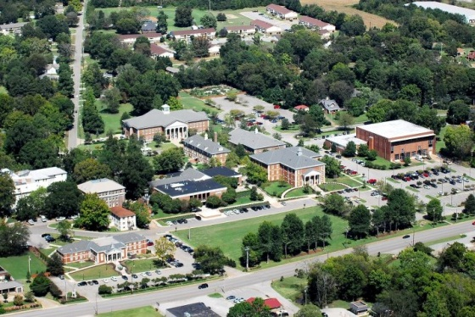
CAMPUS PROJECTS
Beaty Mason – Scope of work for Phase I substantially complete
Phase II bid package being prepared by Architecture Works – will
consist of new electrical and mechanical systems; beginning work to
repair log cabin
ACA Phase II– Design and development work being completed by Live
Design Architects; work will commence on construction bid documents
in February 2014
Comprehensive Facility Master Plan – Working with PH&J Architects
to develop a master plan to guide future campus projects

Slide 13

LEGISLATIVE AGENDA
Local delegation sponsoring legislation to amend Alabama Code dealing with “four-year universities and their governing boards”
Budget hearings conducted on January 14, 2014 – PEEHIP, Rainy Day Fund, PACT Program
Following Reciprocity Legislation – Alabama only State in SREB to not have a signed agreement

Slide 14

CAPITAL CAMPAIGN
ANNUAL FUND
Gifts/Pledges
as of December 2013 $2,551,706
New Stretch Goal $4 million

Slide 15
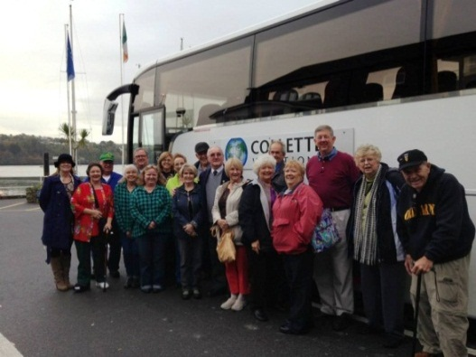

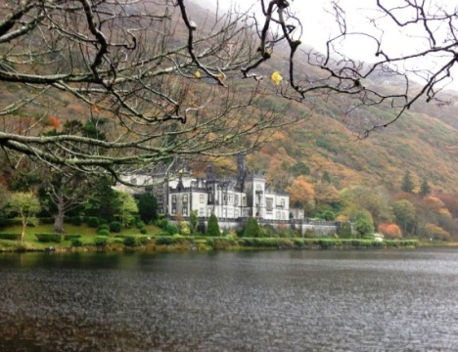
ALUMNI UPDATE
Successful Alumni Trip to Ireland
President’s Ball 2015
Pam Shephard (Chair)
Genie Woodroof (Co-Chair)

Slide 16

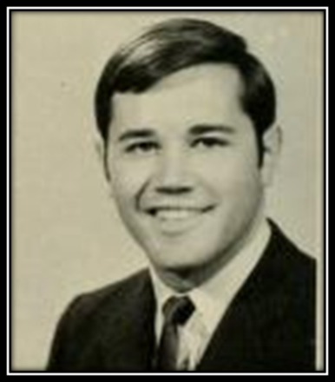
ALUMNI AFFAIRS HIGHLIGHTS
Established Young Alumni Advisory Council
Awarded 45 Alumni Scholarships totaling $43,900
Created the JJ and Dottie Donahue SGA President Endowed Scholarship
Sponsored 30 Alumni Events
Topped $25,000 in pledges to 2013 Phone-a-Thon
Had 559 pledges up 22.4 percent over the previous year

Slide 17
MARKETING/PUBLIC RELATIONS HIGHLIGHTS
Athens State University named among the most affordable institutions of higher education in two national publications – AffordableCollegesOnline.com and OnlineU.com
Athens State University’s Center for Religious Studies and Ethics was renamed the Curtis Coleman Center for Religious Studies and Ethics. The name bestowed honors Professor Emeritus Dr. Curtis Coleman.
Athens State University has once again been named a Military Friendly School by G.I. Jobs Magazine.
Facebook – 8500 friends (doubled in 2013) Twitter – 607 followers

Slide 18
MODERNIZING
MARKETING STRATEGY
2013 was defined by the overall goal
of modernizing our marketing strategy.
Adult Degree Program
4 key elements
  Brand Strategy
  Communication Strategy
  Marketing Strategy
  Set Campaign Goals and Metrics
  2014 will be to further develop our strategy by:
  Creating an organization wide Customer Relationship Management System (Salesforce)
  Continuing the development of our “Smart Degree” brand
  Continuing to refine, analyze and evaluate our digital marketing initiatives

Slide 19
SPRING 2014
ENROLLMENT
Goal of 3349 students
  Budget hours 30,500 credit hours
3104 current headcount
  28,939 current credit hour production
Enrollment is down 1561 credit hours or 5% from projected budget.
Notes:
We are not where we want to be with enrollment. We are behind in our strategic goal of 4000 students by 2015 with 4% annual increases.
We are implementing changes to refocus our culture more deliberately to meet the Board’s goals and policy.

Slide 20

ENROLLMENT AND STUDENT SERVICES RECENT CHANGES
Recruiting and Veterans Affairs have been merged into the Admissions Office
  New VA advisor appointed in October
  2 new recruiters hired to start January 27th
The Transfer Advising Center transitioning to Transfer Student Success Center
Notes:
Our highest priorities are growth in enrollment and improved retention. Toward that end we have made several changes in the past few months—

Slide 21
ENROLLMENT AND STUDENT SERVICES - MOVING FORWARD
Enrollment Management Plan
Customer Relationship Management tool
  Currently testing Salesforce as CRM tool
  Structuring a communication plan
Degree Works – Degree Audit Program
Enrollment Task Force to be created
Notes:
Other processes are also being implemented –
3 year rolling EMP is being developed--outlining activities to be undertaken by each area in support our enrollment goals
CRM tool in a collaborative effort with Marketing -supports recruitment and enrollment tracking through the stages of the enrollment funnel with specific communication plans to ensure the right information to the right student at the right time
Deployment of Degree Works for academic support is on track- we expect the hardware to be in place and software ready to be installed by the end of the month- move forward with building the setup for the degree audit program,
Dr. Glenn has called for an Enrollment Task Force to look at all options for building enrollment – marketing, student support services, program delivery methods, scheduling
Including accelerated courses, a return to the quarter system or more Saturday classes. We expect to name the Task Force by the end of January and begin work immediately

Slide 22
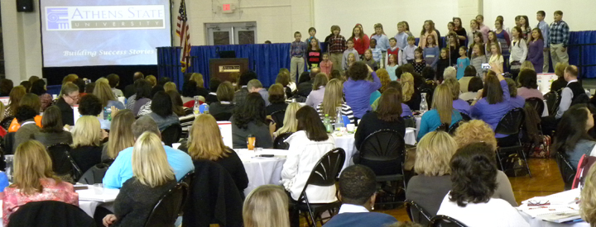
ANNOUNCEMENTS
February 5-7, 2014 – Carter Gymnasium
Leader in Me Symposium
Keynote Speakers: Daniel Pink, author of A Whole New Mind
Special Guest: Sean Covey, Senior Vice President, Franklin Covey

Slide 23
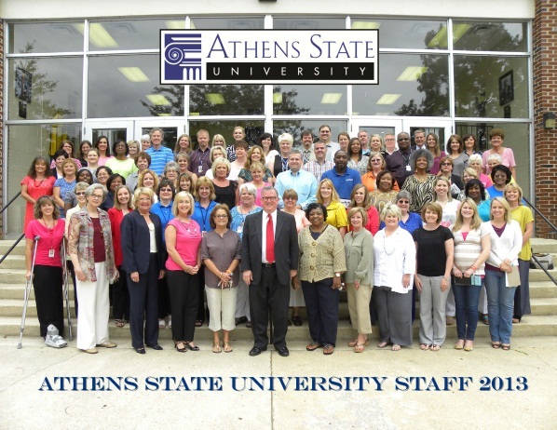
ANNOUNCEMENTS
February 28, 2014 - Faculty/Staff Meeting
*8:30 am - 9:00 am - Coffee Gymnasium
*9:00 am – 10:15 am – Speaker Gymnasium
Dr. James H. Johnson, Jr., Director
Urban Investment Strategies Center
University of North Carolina at Chapel Hill
10:30 – 11:45 – Board of Visitors meet with individual Colleges
12:00 Noon – BOV Luncheon with the President
*All faculty and staff are encouraged to attend

